Slide 1

Cost function
Neural Networks: Learning
Machine Learning

Slide 2







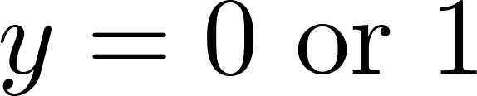
Neural Network (Classification)
total no. of layers in network
no. of units (not counting bias unit) in layer
Layer 1
Layer 2
Layer 3
Layer 4
Binary classification
1 output unit
Multi-class classification (K classes)
K output units
E.g. , , ,
pedestrian car motorcycle truck

Slide 3
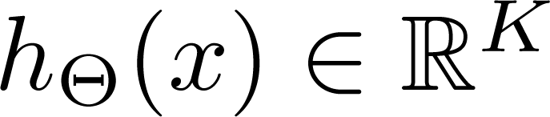
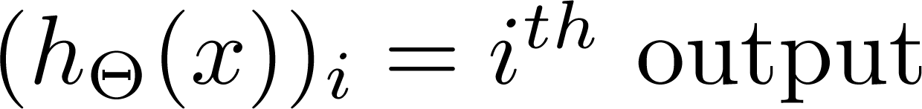
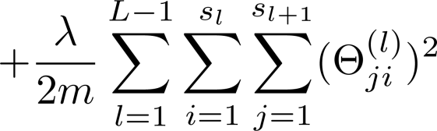
Cost function
Logistic regression:
Neural network:

Slide 4
Backpropagation algorithm
Neural Networks: Learning
Machine Learning

Slide 5
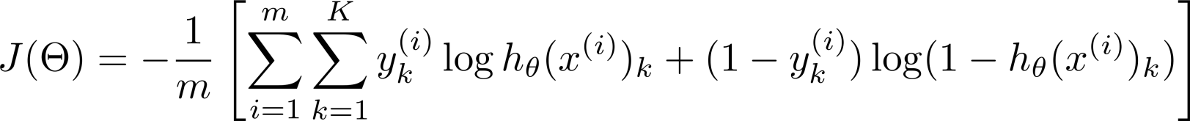
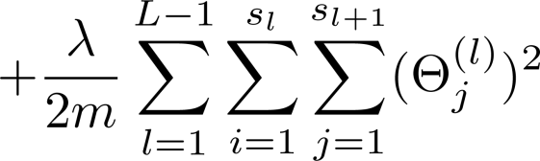
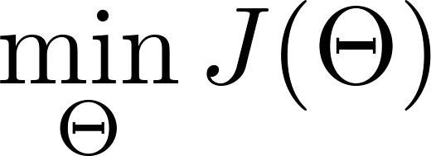
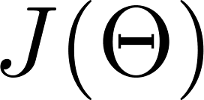
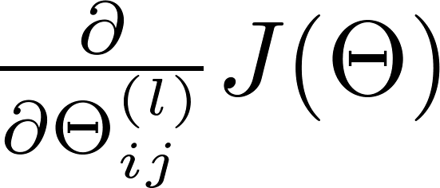
Gradient computation
Need code to compute:

Slide 6


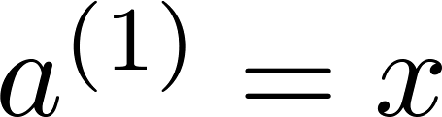
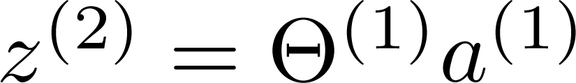
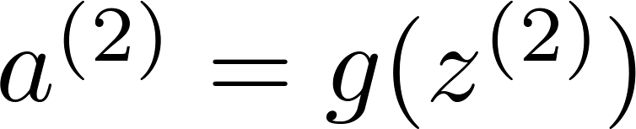
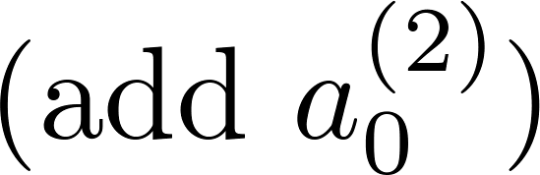
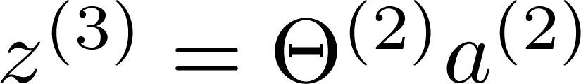
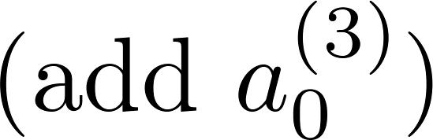
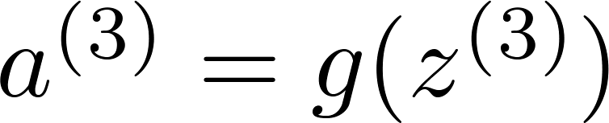
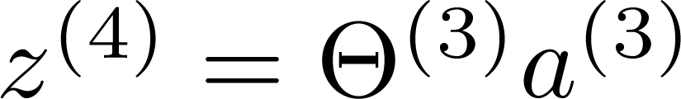
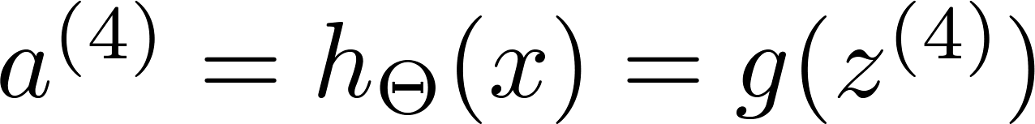
Gradient computation
Given one training example ( , ):
Forward propagation:
Layer 1
Layer 2
Layer 3
Layer 4

Slide 7
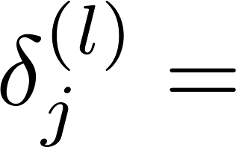

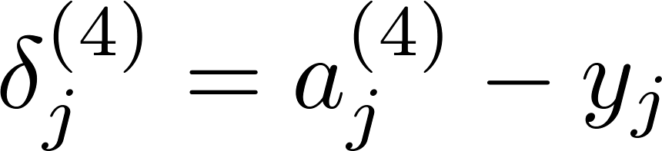
Gradient computation: Backpropagation algorithm
Intuition: “error” of node in layer .
For each output unit (layer L = 4)
Layer 1
Layer 2
Layer 3
Layer 4

Slide 8
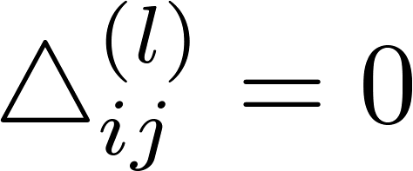


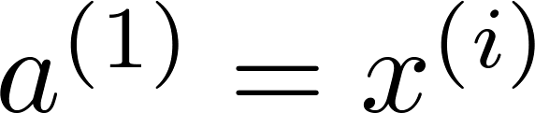

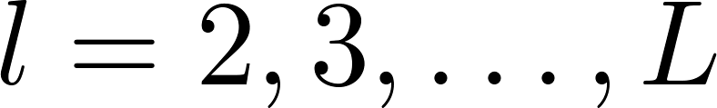

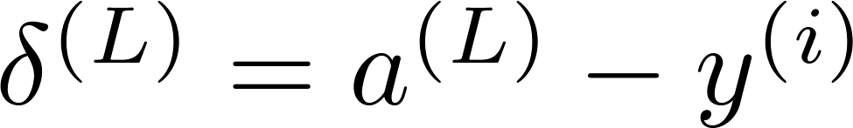
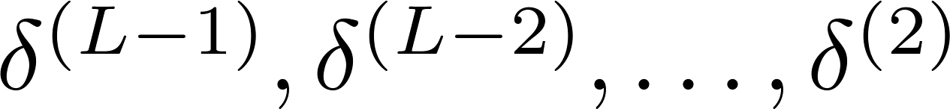
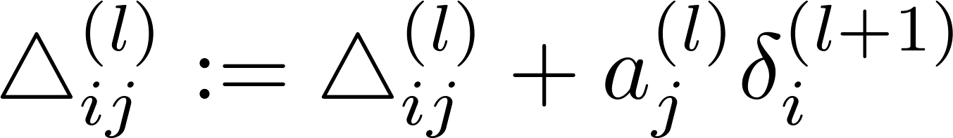
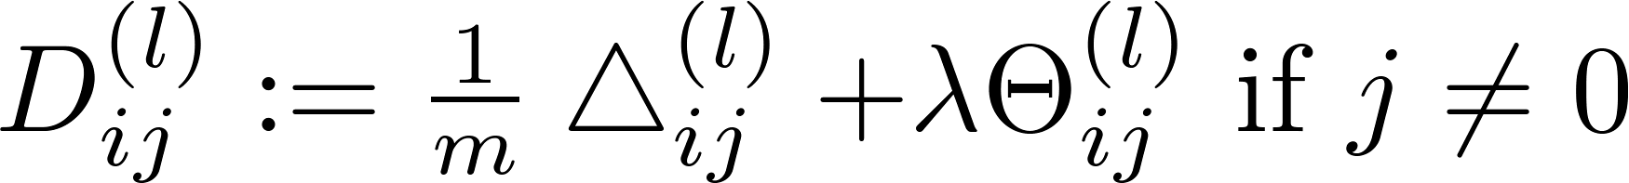
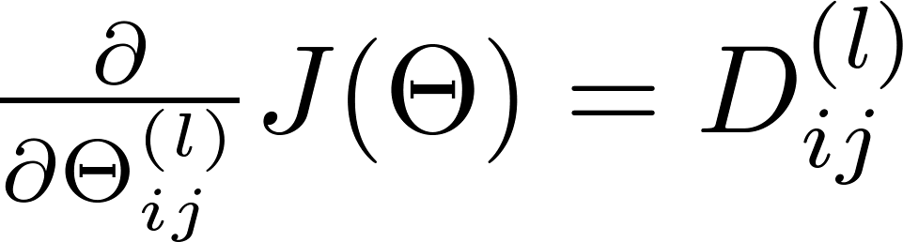
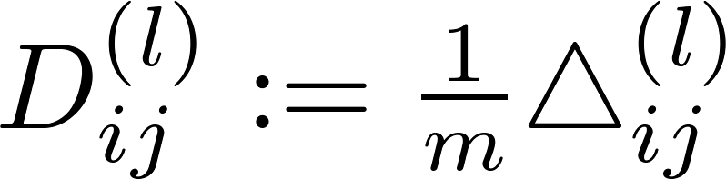

Backpropagation algorithm
Training set
Set (for all ).
For
Set
Perform forward propagation to compute for
Using , compute
Compute

Slide 9
Implementation note: Unrolling parameters
Neural Networks: Learning
Machine Learning

Slide 10
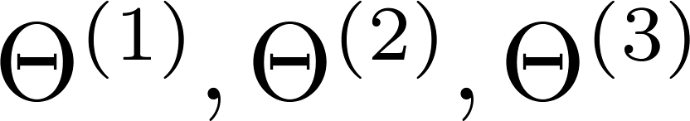
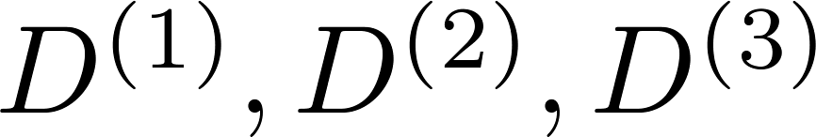
Advanced optimization
function [jVal, gradient] = costFunction(theta)
optTheta = fminunc(@costFunction, initialTheta, options)
…
Neural Network (L=4):
- matrices (Theta1, Theta2, Theta3)
- matrices (D1, D2, D3)
“Unroll” into vectors

Slide 11

Example
thetaVec = [ Theta1(:); Theta2(:); Theta3(:)];
DVec = [D1(:); D2(:); D3(:)];
Theta1 = reshape(thetaVec(1:110),10,11);
Theta2 = reshape(thetaVec(111:220),10,11);
Theta3 = reshape(thetaVec(221:231),1,11);

Slide 12

Learning Algorithm
Have initial parameters .
Unroll to get initialTheta to pass to
fminunc(@costFunction, initialTheta, options)
function [jval, gradientVec] = costFunction(thetaVec)
From thetaVec, get .
Use forward prop/back prop to compute and .
Unroll to get gradientVec.

Slide 13
Gradient checking
Neural Networks: Learning
Machine Learning

Slide 14

Numerical estimation of gradients
Implement: gradApprox = (J(theta + EPSILON) – J(theta – EPSILON)) /(2*EPSILON)

Slide 15

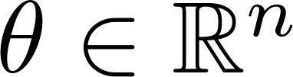
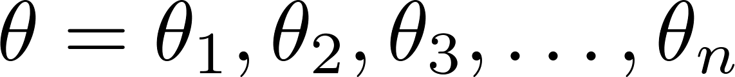
Parameter vector
(E.g. is “unrolled” version of )

Slide 16
for i = 1:n,
thetaPlus = theta;
thetaPlus(i) = thetaPlus(i) + EPSILON;
thetaMinus = theta;
thetaMinus(i) = thetaMinus(i) – EPSILON;
gradApprox(i) = (J(thetaPlus) – J(thetaMinus))
/(2*EPSILON);
end;
Check that gradApprox ≈ DVec

Slide 17
Implementation Note:
Implement backprop to compute DVec (unrolled ).
Implement numerical gradient check to compute gradApprox.
Make sure they give similar values.
Turn off gradient checking. Using backprop code for learning.
Important:
Be sure to disable your gradient checking code before training your classifier. If you run numerical gradient computation on every iteration of gradient descent (or in the inner loop of costFunction(…))your code will be very slow.

Slide 18
Random initialization
Neural Networks: Learning
Machine Learning

Slide 19

Initial value of
For gradient descent and advanced optimization method, need initial value for .
optTheta = fminunc(@costFunction, initialTheta, options)
Consider gradient descent
Set ?
initialTheta = zeros(n,1)

Slide 20
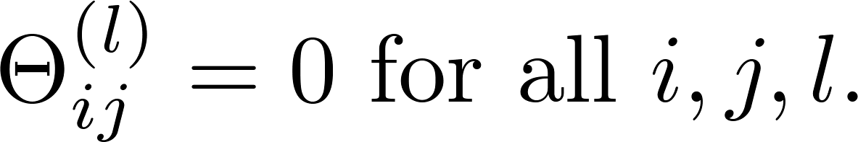



Zero initialization
After each update, parameters corresponding to inputs going into each of two hidden units are identical.

Slide 21
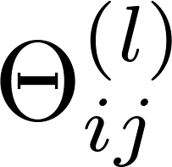
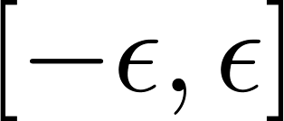
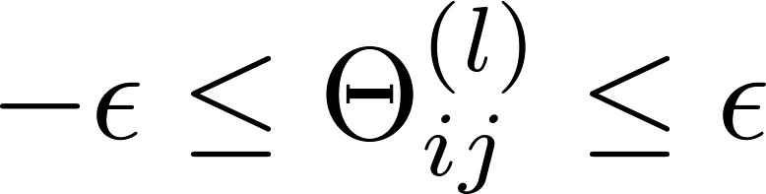
Random initialization: Symmetry breaking
Initialize each to a random value in
(i.e. )
E.g.
Theta1 = rand(10,11)*(2*INIT_EPSILON)
- INIT_EPSILON;
Theta2 = rand(1,11)*(2*INIT_EPSILON) - INIT_EPSILON;

Slide 22
Backpropagation example: Autonomous driving (optional)
Neural Networks: Learning
Machine Learning

Slide 23
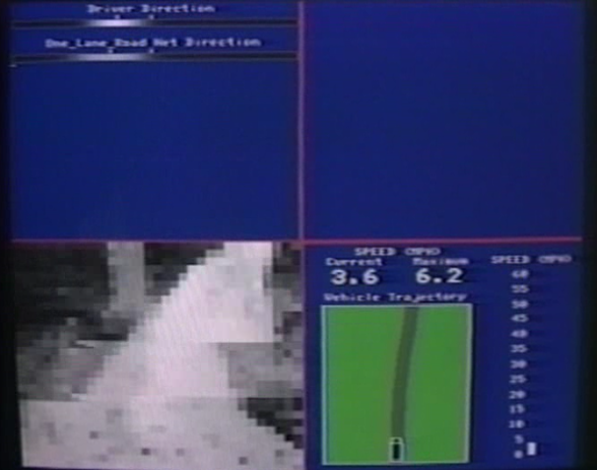
[Courtesy of Dean Pomerleau]

